Slide 1
Real- Time Operating System (RTOS) based Embedded System Design
Mallikarjuna naik B
Asst.Professor
CRIT

Slide 2
Operating System Basics
Acts as a bridge between the user applications/ tasks and the underlying system resources through a set of system functionalities and services.
The primary functions of an operating system is
Make the system convenient to use
Organize and manage the system resources efficiently and correctly.

Slide 3
Kernel
Core of the operating system and is responsible for managing the system resources and the communication among the hardware and other system services.
Contains a set of system libraries and services.
For a general purpose OS, the kernel contains the different services for handling the following
Process management
Primary memory management
File system management
Time management
I/O system management
Secondary storage management

Slide 4
Operating System Architecture
User Applications
Application programming interface (API)
Memory management
Kernel services
Process management
Time management
File system management
I/O system management
Device driver interface
Underlying hardware

Slide 5
Process Management
Deals with managing processes/tasks.
Setting up memory space for the process, loading the process’s code into the memory space, allocating system resources, scheduling and managing the execution of the process, setting up and managing the Process Control Block(PCB), inter process communication and synchronization, process termination deletion, etc.

Slide 6
Primary Memory Management
Refers to the volatile memory (RAM) where the processes are loaded and variables and shared data associated with each process are stored.
The Memory Management Unit (MMU) is responsible for
Keeping track of which part of the memory area is currently used by which process.
Allocating and de-allocating memory space on a need basis(dynamic memory allocation).

Slide 7
File system management
File is a collection of related information.
Could be a program code, audio file, video file, image file, document file, text file, etc.
Each of these files differ in the kind of information they hold and the way in which the information is stored.

Slide 8
File system management
The file system management service of kernel is responsible for
The creation, deletion and alteration of files.
Creation, deletion and alteration of directories.
Saving of files in the secondary storage memory(Hard disk drive)
Providing automatic allocation of file space based on the amount of free space available
Providing a flexible naming convention for the files

Slide 9
I/O System Management
Routing the I/O requests coming from different user applications to the appropriate I/O devices of the system.
In a well-structured OS, the direct accessing of I/O devices are not allowed and the access to them are provided through a set of Application Programming Interfaces (API’s) exposed by the kernel.
Kernel maintains the list of I/O devices of the system.

Slide 10
I/O System Management
The service ‘Device Manager’ of the kernel is responsible for handling all I/O device related operations.
The kernel talks to the I/O device through a set of low-level system calls, which are implemented in a service, called device drivers.
Device manager is responsible for
Loading and unloading of device drivers
Exchanging information and the system specific control signals to and from the device.

Slide 11
Secondary Storage Management
Deals with managing the secondary storage devices, if any, connected to the system.
In most of the systems, the secondary storage is kept in disks (Hard Disk).
The secondary storage management service of the kernel deals with
Disk storage allocation
Disk scheduling
Free disk space management

Slide 12
Protection systems
To support multiple users with different levels of access permissions.
Main motto is to restrict the access to the unauthorized persons.
In multiuser supported operating systems, one user cannot access or modify the data of other user.
Some applications may not be granted with permission to make use of some of the kernel system resources.

Slide 13
Interrupt Handler
Kernel will provide interrupt handling capability for all external/internal generated interrupts.

Slide 14
Kernel space and User space
Applications/services are classified into two categories, they are
User applications
Kernel applications
Program code corresponding to the kernel applications/services are kept in a attached area of primary memory and is protected from unauthorized access by user programs/applications.
Memory space at which kernel code is written is known as ‘Kernel Space’.

Slide 15
User space
All user applications are loaded to a specific area of primary memory and this memory area is known as ‘User Space’.
This is the area where user applications are loaded and gets executed.
Partitioning of memory into kernel and user space is purely dependent on type of operating system.
In an OS with virtual memory support, the user applications are loaded into its corresponding virtual memory space with demand paging technique.

Slide 16
Contnd…
The entire code for the user application need not be loaded to the main memory at once, instead the user application is split into different pages and these pages are loaded into and out of main memory area on a need basis.
This process of loading the code into and out of main memory is known as ‘Swapping’.
Most of the operating systems keep the kernel application code in main memory and is not swapped out into secondary memory.

Slide 17
Monolithic Kernel and Microkernel
Different approaches are adopted for building an operating system kernel. Based on the kernel design, kernels can be classified into ‘Monolithic’ and ‘Micro’.
Monolithic kernel:
All kernel services run in kernel space.
Applications
Monolithic kernel with all operating system services running in kernel space

Slide 18
Monolithic Kernel and Microkernel
Microkernel :
Only the essential set of operating system services into the kernel.
Rest of the OS services are implemented in programs known as servers which runs in user space.

Slide 19
Micro-kernel
Servers (Kernel services running in user space)
Applications
Microkernel with essential services like memory management, process management, timer management etc…

Slide 20
Types of Operating Systems
General Purpose Operating System(GPOS):
OS which are deployed in general computing systems are referred as General Purpose Operating Systems(GPOS).
Examples: Windows XP/MS-DOS, VISTA, Windows 7/8
Real Time Operating system(RTOS):
Deterministic timing behavior.
Implements policies and rules which are time-critical allocation of a system’s resources.

Slide 21
The Real-Time Kernel
Kernel of a real time operating system is referred as real time kernel.
Real time kernel is highly specialised and it contains only minimal set of services required for running the user applications/tasks.
Task/Process management
Task/Process scheduling
Task/Process synchronization
Error/Exception handling
Memory management
Interrupt handling
Time management

Slide 22
Task/Process management
Setting up memory space for the tasks, loading the task’s code into the memory space, allocating system resources, setting up a Task Control Block (TCB) for the task.
TCB is responsible for holding the information corresponding to a task.
TCB contains
Task ID: Task Identification number
Task state: Current state of the task
Task type: Hard real time or Soft real time or background task
Task priority: Task Priority
Task context pointer: context pointer
Task memory pointers: pointers to the code, data and stack memory
Task system resource pointers: pointers to system resources(semaphores, mutex)
Task pointers: pointers to other TCBs

Slide 23
Task Control Block(TCB)
Parameters and implementation of the TCB is kernel dependent.
May vary for different kernels, based on the task management.
Task management services utilizes the TCB of a task in the following way
Creates a TCB for a task on creating a task
Delete/remove the TCB of a task when the task is terminated or deleted
Reads the TCB to get the state of a task
Update the TCB with updated parameters on need basis
Modify the TCB to change the priority of the task dynamically.

Slide 24
Task/ Process scheduling
Deals with sharing the CPU among various tasks/processes.
A kernel application called ‘scheduler’ handles the task scheduling.
Scheduler is an algorithm implementation, which performs the efficient and optimal scheduling of tasks to provide a deterministic behavior.

Slide 25
Task/ Process synchronization
Deals with synchronization the concurrent access of a resource, which is shared across multiple tasks and the communication between various tasks.

Slide 26
Error/ exception handling
Deals with registering and handling the errors occurred/exceptions raised during the execution of tasks, insufficient memory, timeouts, deadlocks, deadline missing, bus error, divide by zero, unknown instruction execution, etc. are the examples.
These tasks will wait indefinitely when the external device is not responding and the task will generate a hang-up behavior.

Slide 27
Memory Management
Compared to GPOS, the memory management of the RTOS it is slightly different.
As memory size is more then it will take lot of time to allocate.
RTOS makes use of ‘block’ based memory allocation technique instead of the usual ‘dynamic memory’ based allocation techniques used by GPOS.
RTOS kernel uses blocks of fixed size of dynamic memory and the block is allocated for a task on a need basis.
The blocks are stored in a ‘Free Buffer Queue’.

Slide 28
Memory Management
To achieve predictable timing and avoid timing overheads, most of the RTOS kernel allow tasks to access any of the memory blocks without any protection.
Some RTOS kernel allow memory protection as optional and the kernel enters into a fail-safe mode when an illegal memory access occurs.
A few RTOS kernels implement ‘Virtual Memory’ concept for memory allocation if the system supports secondary storage(like HDD and FLASH memory).

Slide 29
Interrupt Handling
Deals with the handling of various types of interrupts.
Interrupts provide real time behavior to systems, will inform the processor that an external device or an associated task requires immediate attention of the CPU.
Can be either Synchronous or Asynchronous.
Interrupts which occurs in sync with the currently executing task is known as Synchronous interrupts.

Slide 30
Interrupt Handling
Usually the software interrupts fall under the synchronous interrupt category, divide by zero, memory segmentation error, etc. are the examples of synchronous interrupts.
Asynchronous interrupts will occur at any point of execution of any task, and are not in sync with the currently executing task.
Timer overflow interrupts, serial data reception/ transmission interrupts etc. are examples of asynchronous interrupts.

Slide 31
Time management
In Real Time OS there should be an essential precise time reference from time management section for all applications.
Time reference to kernel is provided by a high resolution Real Time Clock(RTC) hardware chip(hardware timer).
The hardware timer is programmed to interrupt the processor/controller at a fixed rate. This timer interrupt is referred as ‘Timer tick’.
The timer tick is taken as the timing reference by the kernel.

Slide 32
Time Management
The timer tick may vary depending on the hardware timer.
The time parameters for tasks are expressed as the multiples of the ‘Timer tick’.
The system time is updated based on the ‘Timer tick’.

Slide 33
Time management
The timer tick interrupt is handled by the timer interrupt handler of kernel.
The timer tick can be utilized for implementing the following actions
Save the current context( context of the currently execution task).
Increment the system time register by one. Generate timing error and reset the system time register if the timer tick count is greater than the maximum value.
Update the timers implemented in kernel( Increment or Decrement).
Activate the periodic tasks, which are in the idle state.
Invoke the scheduler and schedule the tasks again based on the scheduling algorithm.
Delete all the terminated tasks and their associated data structures(TCBs).

Slide 34
Hard Real-Time
Real Time OS that follow the timing constraints strictly for a task is referred as Hard Real-Time systems.
Missing any deadlines may produce erroneous results for Hard real time systems, including data loss and irrecoverable damages to the system/users.
Air bag control systems and Anti-lock Brake systems are typical examples of Hard real time systems.
Does not implement the virtual memory model for handling memory, hence eliminates delay.

Slide 35
Soft Real-Time
Real time Operating Systems that does not need any kind of deadlines, but offer the best effort to meet the deadline are referred as ‘Soft Real Time’ systems.
Missing tasks are acceptable if the frequency of deadline missing is within the limit of the Quality of Service(QoS).
Automatic Teller Machine is the typical example for Soft Real Time systems.
Audio-video player is another example.

Slide 36
Tasks, Process and Threads
Task:
Refers to something that’s need to be done.
It is defined as the program in execution and the related information maintained by the operating system for the program.
Task is also known as ‘Job’ in the operating system context.
A program or part of it in execution is also called a ‘Process’.

Slide 37
Tasks, Process and Threads
Process:
A process is a program, or part of it, in execution.
It is also known as an instance of a program in execution.
A process requires various system resources like CPU for executing the process, memory for storing the code corresponding to the process and associated variables, I/O devices for information exchange, etc.
A process is sequential in execution.

Slide 38
Structure of a Process
Concept of process leads to concurrent execution of tasks and efficient utilization of CPU and other resources.
Process
Stack (stack pointer)
Working registers
Status registers
Program counter (PC)
Code memory corresponding to the process

Slide 39
Memory organization of a Process
Stack memory holds all temporary data such as variables local to the process.
Data memory holds all global data for the process.
The code memory contains the program code corresponding to the process.
Stack Memory
Stack Memory grows downwards
Data Memory grows upwards
Data Memory
Code Memory

Slide 40
Process states and State transitions
Creation to termination of a process is not a single step operation.
The cycle through which a process changes its state from ‘newly created’ to ‘execution completed’ is known as ‘Process Life Cycle’.

Slide 41
Created
Incepted into memory
Ready
I/O completion
Interrupt or preempted
Shared resource acquired
Blocked
Scheduled for execution
Waiting for I/O
Running
Waiting for shared resource
Execution completion
Completed

Slide 42
Threads
Thread is the primitive that can execute code. It is a single sequential flow of control within a process.
Also known as light weight process. A process can have many threads of execution.
Different threads which are part of a process, share the same address space; meaning they share the data memory, code memory and heap memory area.
Threads maintain their own thread status (CPU register values), Program Counter (PC) and stack.

Slide 43
Memory organization of a process and its associated threads
Stack memory for Thread 1
Stack memory for Thread 2
Stack Memory for process
Data memory for process
Code memory for process

Slide 44
Multithreading
A process/task in embedded application may be a complex or lengthy one and it may contain various sub operations like getting input from I/O devices connected to the processor, performing some internal calculations/operations, updating some I/O devices etc.
If all the sub functions of a task are executed in sequence, the CPU utilization may not be efficient.

Slide 45
Multithreading
For example, if the process is waiting for a user input, the CPU enters into a wait state for the event, and the process execution also enters a wait state.
If the task is split into different threads carrying out the different sub functions of the process, the CPU can be effectively utilized and when the thread to the corresponding I/O operation enters the wait state, another threads which do not require I/O event for their operation can be switched into execution.

Slide 46
Task Process
Code memory
Data memory
Stack
Stack
Stack
Registers
Registers
Registers
Thread 1
Thread 2
Thread 3
Create child thread 1
Child thread 1
Child thread 2
Create child thread 2

Slide 47
Thread Pre-emption
Thread pre-emption is the act of pre-empting the currently running thread( stopping the currently running thread temporarily).
Thread pre-emption is performed for sharing the CPU time among all the threads.
The execution switching among threads are known as ‘Thread context switching’.

Slide 48
Types of Threads
1. User Level Thread
2. Kernel/ System Level Thread
User Level Thread:
Do not have kernel/Operating system support and they exist solely in the running process.
Even if a process contains multiple user level threads, the OS treats it as single thread and will not switch the execution among the different threads of it.
It is the responsibility of the process to schedule each thread as and when required.
Non-preemptive at thread level from OS perspective.

Slide 49
Types of Threads
Kernel/ System Level Thread:
Kernel level threads are individual units of execution, which the OS treats as separate threads.
The OS interrupts the execution of the currently running kernel thread and switches the execution to another kernel thread based on scheduling policies implemented by the OS.
These are pre-emptive.

Slide 50
For user level threads, the execution switching happens only when the currently executing thread is voluntarily blocked.
No OS intervention and system calls are involved in the context switching of user level threads. This makes context switching of user level threads very fast.
Kernel level threads involves lot of kernel overhead and involve system calls for context switching.

Slide 51
Thread binding models
There are many ways for binding user level threads system/ kernel level threads. They are
Many-to- One Model:
Many user level threads are mapped to a single kernel thread.
Kernel treats all user level threads as single thread and the execution switching among the user level threads happens when a currently executing user level thread voluntarily blocks itself or relinquishes the CPU.

Slide 52
Thread binding models
One-to-One Model:
Each user level thread is bonded to a kernel/system level thread.
Many-to-Many Model:
Many user level threads are allowed to be mapped to many kernel threads.

Slide 53
Multiprocessing and Multitasking
The ability to execute multiple processes simultaneously is called multiprocessing
Systems which are capable of performing multiprocessing, are known as multiprocessor systems. Multiprocessor systems posses multiple CPU’s and can execute multiple processes simultaneously.
The ability of the operating system to have multiple programs in memory, which are ready for execution, is referred as multiprogramming.

Slide 54
Multitasking
In a uniprocessor system, it is not possible to execute multiple processes simultaneously but can be achieved by switching the execution among different processes.
The ability of an OS to hold multiple processes in memory and switch the processor from executing one process to another process is called multitasking.
Multitasking creates the illusion of multiple tasks executing in parallel.

Slide 55
Multitasking
Process is considered as a virtual processor, awaiting its turn to have its properties switched into physical processor.
Switching of virtual processor to physical processor is done by scheduler of the OS kernel.
Whenever a CPU switching happens, the current context has to be saved to retrieve it at a later point of time when the CPU executes the process, which is interrupted due to execution switching.

Slide 56
Multitasking
The act of switching CPU among the processes or changing the current execution context is known as ‘Context Switching’.
The act of saving the current context which contains the context details( Register details, memory details, system resource usage details, execution details, etc.) for the currently running process at the time of CPU switching is known as ‘Context saving’.
The act of retrieving the saved context details for a process, which is going to be executed due to CPU switching, is known as ‘Context retrieval’.

Slide 57
Types of Multitasking
Depending on how the switching act is implemented, multitasking can be classified into different types. They are
Co-operative multitasking:
Most simple form of multitasking in which tasks/process gets a chance to execute only when the currently executing task/process voluntarily relinquishes the CPU.
In this type any task/process can hold CPU as much time it wants.

Slide 58
Types of multitasking
Preemptive multitasking:
Ensures that every task/process gets a chance to execute.
When and how much time a process gets is dependent on the implementation of the preemptive scheduling.
The preemption of task may be based on time slots or task/process priority.

Slide 59
Types of multitasking
Non-preemptive multitasking:
The process/task, which is currently given the CPU time, is allowed to execute until it terminates or enters the ‘Blocked state’ waiting for an I/O or system resource.
The co-operative and non-preemptive multitasking differs in their behavior when they are in the ‘Blocked/wait state’.

Slide 60
Task scheduling
There should be some mechanism in place to share the CPU among the different tasks and to decide which process/task is to be executed at a given point of time.
Determining which process/task should be executed at a given point of time is known as task/process scheduling.

Slide 61
Task scheduling
The process scheduling decision may take place when a process switches its state to
1. ‘Ready state from ‘Running’ state
2. ‘Blocked/wait state from ‘Running’ state
3. ‘Ready’ state from ‘Blocked/wait’ state
4. ‘Completed’ state

Slide 62
Selection of scheduling algorithm
The selection of a scheduling algorithm should be consider the following factors:
CPU Utilization:
The scheduling algorithm should always make the CPU utilization high. CPU utilization is a direct measure of how much percentage of the CPU is being utilized.
Throughput:
Number of processes executed per unit of time. It should be higher.

Slide 63
Turnaround Time:
It is the amount of time taken by a process for completing execution.
It includes the time spent by the process for waiting for main memory, time spent in the ready queue, time spent on completing I/O operations, and the time spent in execution.
Turnaround time should be minimal for a good scheduling algorithm.

Slide 64
Waiting Time:
It is the amount of time spent by a process in the ready queue waiting to get the CPU time for execution.
Waiting time should be minimal for a good scheduling algorithm.
Response Time:
It is the time elapsed between the submission of a process and the first response.

Slide 65
Queues
Operating system maintains various queues in connection with CPU scheduling, and a process passes through these queues during the course of its admittance to execution completion.
Job queue:
Contains all the processes in the system.
Ready queue:
Contains all the processes, which are ready for execution and waiting for CPU to get their turn for execution.

Slide 66
Queues
Device queue:
Contains the set of processes, which are waiting for an I/O device.

Slide 67
Types of scheduling
Non-preemptive scheduling:
Systems which implement non-preemptive multitasking model.
In this type of scheduling the currently executing task/process is allowed to run until it terminates or enters the ‘wait’ state waiting for an I/O or system resource.
The various types of non-preemptive scheduling algorithms are
1.FCFS/FIFO: First Come First Service
2.LCFS/LIFO: Last Come First Service
3.SJF scheduling: Shortest Job First
4.Priority based scheduling

Slide 68
Non-preemptive scheduling algorithm
First-Come-First-Served(FCFS)/FIFO Scheduling:
Allocates CPU time to the processes based on the order in which they enter the ‘Ready’ queue.
The major drawback of FCFS algorithm is that it favors monopoly of process.

Slide 69
Non-preemptive scheduling algorithm
Last-Come-First Served (LCFS)/LIFO Scheduling:
Allocates CPU time to the processes based on the order in which they are entered in the ‘Ready’ queue.
The last entered process is serviced first.
Shortest Job First (SJF) Scheduling:
‘Sorts’ the ‘Ready’ queue each time a process hand over the CPU to pick the process with shortest estimated completion/run time.

Slide 70
Non-preemptive scheduling algorithm
The average time for a given set of process is minimal in SJF scheduling and so it is optimal compared to other non-preemptive scheduling like FCFS.
Major drawback of this algorithm is that a process whose estimated execution time is high may not get the chance to execute if more and more processes with least estimated execution time enters the ‘Ready’ queue before the process with longest estimated execution time started its execution, called ‘Starvation’.

Slide 71
Non-preemptive scheduling algorithms
Another drawback of SJF is that it is difficult to know in advance the next shortest process in the ‘Ready’ queue for scheduling since new process with different estimated time keep entering the ‘Ready’ queue at any point of time.
Priority Based Scheduling:
Priority based non-preemptive scheduling algorithm ensures that a process with highest priority is served first.
SJF is also an priority based scheduling algorithm.
Starvation is present. Can be eliminated by raising priority as time progresses, called ‘Aging’.

Slide 72
Preemptive scheduling
Preemptive scheduling is employed in systems, which implements preemptive multitasking model.
Every task in ‘Ready’ queue gets a chance to execute.
When and how each process gets a chance to execute is dependent on scheduling algorithm.
The act of moving a ‘Running’ process/task into the ‘Ready’ queue by the scheduler, without the process requesting for it is known as ‘Preemption’.

Slide 73
Preemptive scheduling
Two different approaches for preemptive scheduling are
Time based preemption and
Priority based preemption.
Preemptive SJF scheduling/ Shortest Remaining Time:
Incase of non-preemptive SJF algorithm sorts the ‘Ready’ queue only after completing the execution of current process.
Whereas in preemptive SJF algorithm sorts the ‘Ready’ queue when a new process enters into the queue and compare the currently executing process time and if the execution time of new process is shorter then currently executing process is preempted and the new process is scheduled for execution.

Slide 74
Preemptive scheduling
Round Robin (RR) scheduling:
Similar to FCFS but here the time slot based preemption is added to switch between processes in the ‘Ready’ queue.
Process 1
Process 2
Process 3
Process 4
Execution switch
Execution switch
Execution switch
Execution switch

Slide 75
Preemptive scheduling
Priority based scheduling:
Same as that of non-preemptive priority based scheduling except for the switching of execution between the tasks.
In preemptive scheduling as the highest priority process enters it will be immediately scheduled for the execution.

Slide 76
Threads, Processes, Scheduling altogether
Lets assume that we have two process for execution namely Process1 with normal priority and Process 2 with highest priority.
Process1 requires 7.5 units of execution time and after this it will sleep for 17.5 units of execution time and repeated forever.
Process2 requires 10 units of execution time and after this it will sleep for 5 units of execution time and repeated forever.

Slide 77
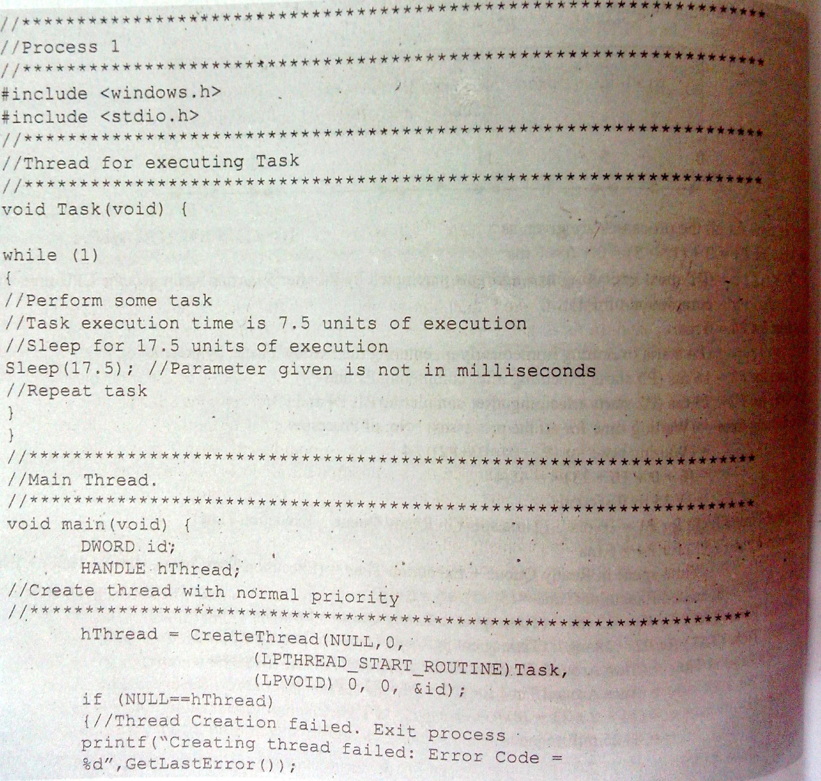

Slide 78
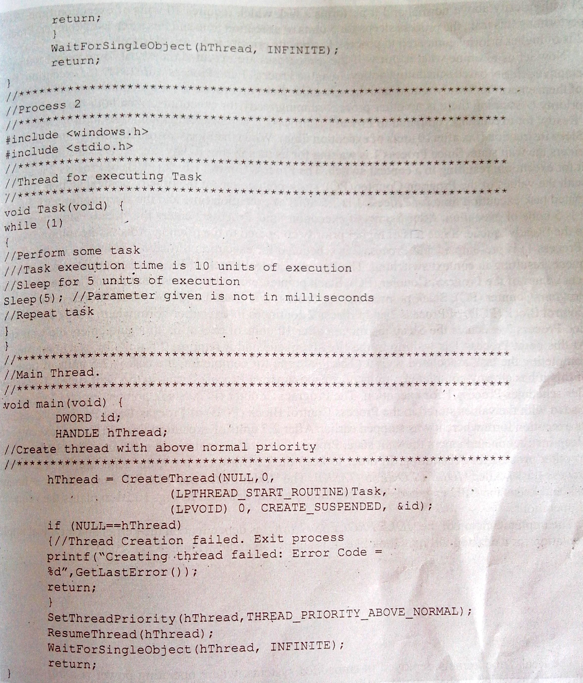

Slide 79
Threads, Processes, Scheduling altogether
Working in Real-Time Kernel with preemptive priority based scheduling policy:
Process1 and Process2 are ready for execution and enters the ready queue and the scheduler picks the Process2 for execution because it is having above normal priority.
Process2 starts executing and runs until it executes the sleep instruction (i.e. after 10 units of execution time).

Slide 80
Threads, Processes, Scheduling altogether
When the Process2 executes the sleep instruction it goes into the wait state.
Process1 is waiting for its turn and the scheduler picks it for execution, resulting in a context switching.
Process Control Block(PCB) of Process2 is updated with the values of PC, SP, etc. at the time of context switching.
As the Process1 executing time is of 7.5 units and the Process2 sleep time is 5 units of execution.

Slide 81
Threads, Processes, Scheduling altogether
After 5 units of execution time, Process2 enters the ready state and to the ready queue.
Since Process2 is with highest priority, scheduler picks it for execution and the currently running process1 is preempted.
Process1 moves into the ready queue resulting in a context switching. PCB of Process1 will be updated by the PC, SP values.

Slide 82
Threads, Processes, Scheduling altogether
PC, SP etc. for Process2 is loaded with the values previously stored in PCB of Process2 and continues the execution from where it has stopped.
Process2 executes the sleep instruction after 10 units of execution time and enters the wait state.
At this point the process1 is waiting in the ready queue and it requires 2.5 units of execution time for completing the task associated with it. Scheduler schedules Process1 for execution.

Slide 83
Threads, Processes, Scheduling altogether
PC, SP etc. for process1 is loaded with the previously stored values in PCB of Process1 and continues from where the execution stopped.
After 2.5 units of execution time, process1 executes the sleep instruction and enters wait state.
Process2 is already in the wait state and scheduler finds no other process for scheduling.

Slide 84
Threads, Processes, Scheduling altogether
In order to keep the CPU always busy, the scheduler runs a dummy process/task called ‘IDLE PROCESS (TASK)’.
Void Idle_Process (void)
{
//simply wait..
//do nothing..
While(1);
}

Slide 85
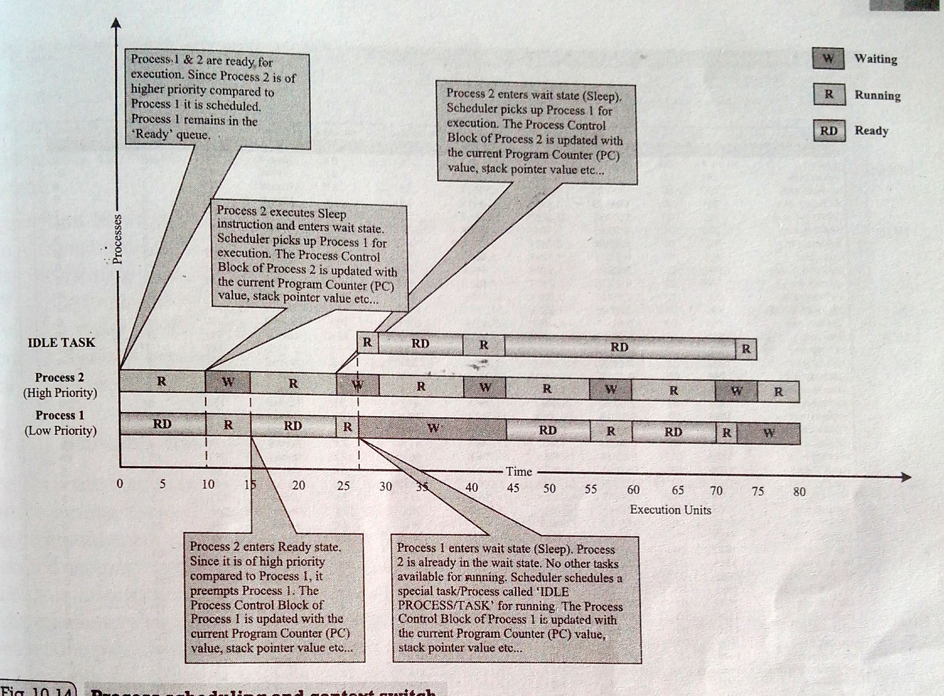

Slide 86
Task Communication
In a multitasking system, multiple tasks/processes run concurrently and each process may or may not interact between.
Based on the degree of interaction, the process running on OS are classified as
1.Co-operating Processes:
One process requires the inputs from other processes to complete its execution.
2. Competing Processes:
Do not share anything among themselves but they share system resources.

Slide 87
Task Communication
Co-operating processes Methods
Co-operating processes communicates and shares information through
Co-operation through sharing:
The co-operating process exchange data through some shared resources.
Co-operation through Communication:
No data is shared between the processes. But they communicate for synchronization.

Slide 88
Shared Memory
Processes share some area of memory to communicate among them. Information to be communicated by the process is written to the shared memory area.
Other processes which require this information can read the same from the shared memory area.
Example: Notice board
Process 1
Shared memory area
Process 2

Slide 89
Shared Memory
The implementation of shared memory concept is kernel dependent. Different mechanisms are adopted by different kernels for implementing this. A few among them are:
PIPES:
‘Pipes’ is a section of the shared memory used by processes for communicating.
Pipes follow the client- server architecture.
A process which creates a pipe is known as pipe server and a process which connects to a pipe is known as pipe client.

Slide 90
Shared Memory
A pipe can be considered as a conduit for information flow and has two conceptual ends.
Can be unidirectional or bidirectional flow.
OS dependent. Microsoft Windows Desktop Operating Systems support two types of ‘Pipes’ for Inter Process Communication. They are Anonymous Pipes and Named Pipes.
Process 1 write
Process 2 Read
Pipe (Named/un-named)

Slide 91
Shared Memory
Memory Mapped Objects:
Allocates a shared block of memory which can be accessed by multiple processes simultaneously.
In this approach mapping object is created and physical storage for it is reserved and committed.
A process can map entire physical area or a block of it to its virtual address space.

Slide 92
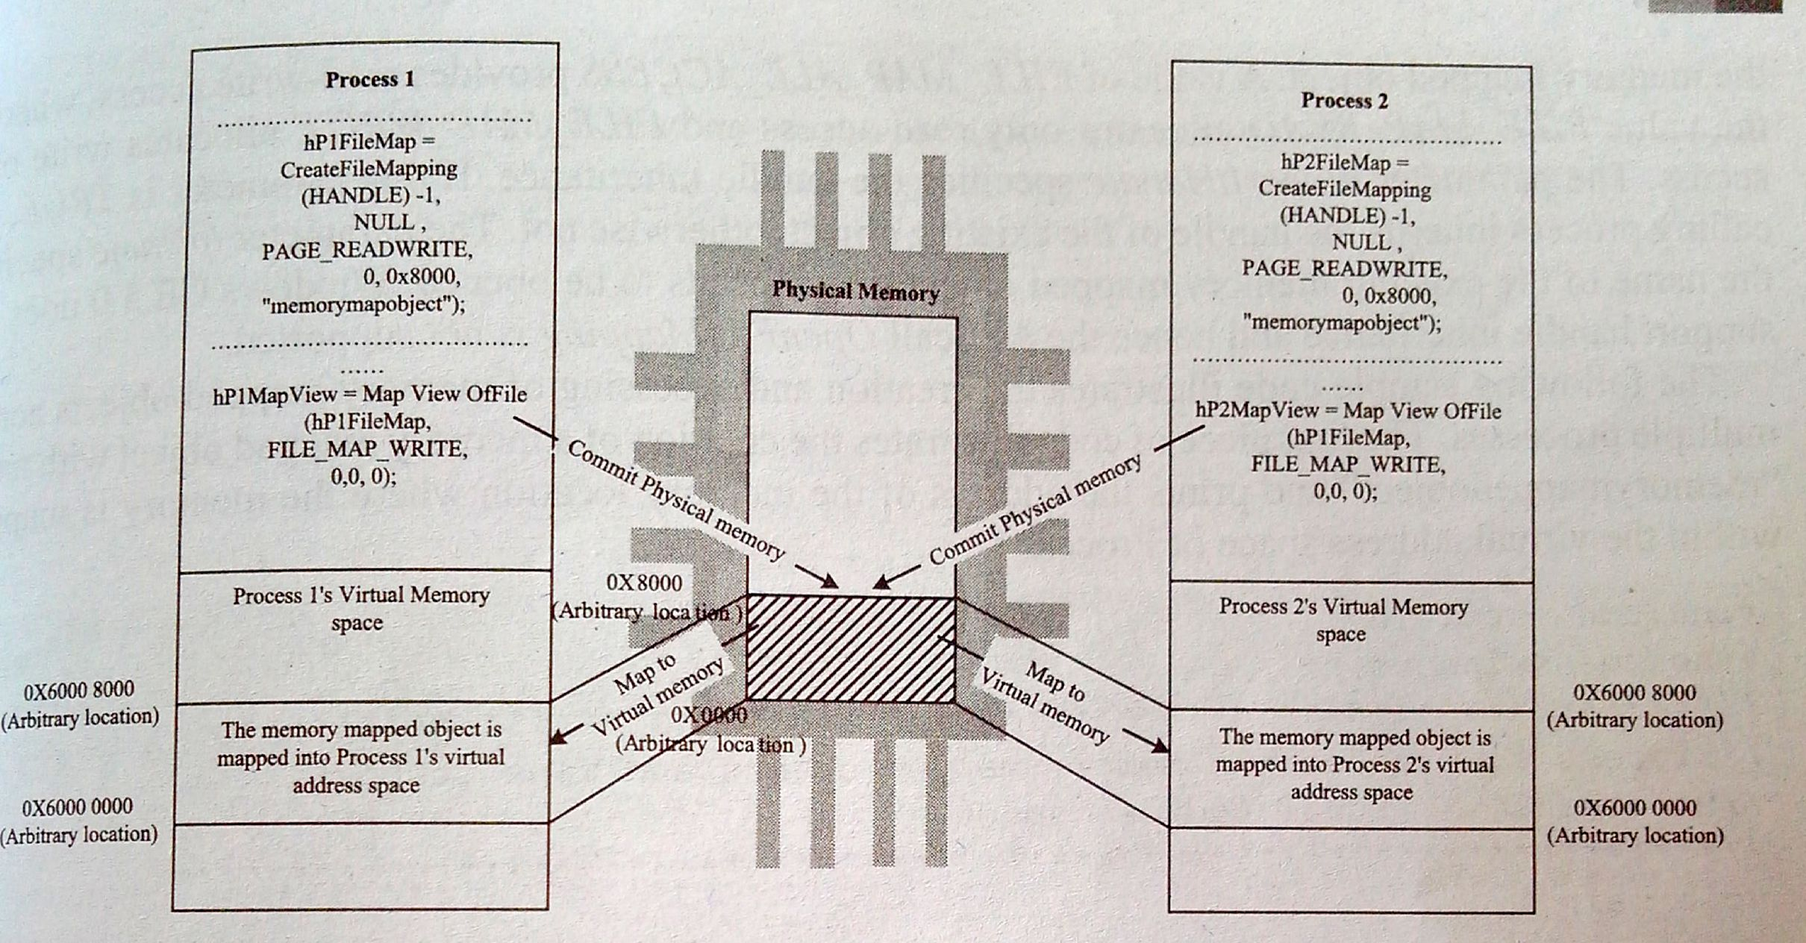

Slide 93
Message passing
Synchronous/Asynchronous information exchange process used for Inter Process/Thread Communication.
Major difference between shared memory and message passing is the amount of data transfer, in case of shared memory lots of data can be shared whereas only limited amount of information is passed in message passing.
Fast and free from synchronization overheads.

Slide 94
Message Passing
Based on the message passing operation between processes, message passing is classified into
Message Queue
Mailbox
Signaling

Slide 95
Message Passing
Message Queue
Process which wants to talk to another process posts the message in a queue(FIFO) called ‘Message Queue’.
Message queue
Send message
Receive message
Process 1
Process 2

Slide 96
Message Passing
Mailbox
Alternate form of ‘Message queues’ and it is used in certain Real-Time Operating systems for IPC.
Mailbox technique for IPC in RTOS is usually used for one way messaging.
The task/thread which wants to send messages to other tasks/threads creates a mailbox for posting messages.
The threads which are interested in receiving messages posted to mailbox by the mailbox creator(mailbox server) thread can subscribe (mailbox clients) to the mailbox.

Slide 97
Message Passing
Signaling
Primitive way of communication between processes.
Signals are used for asynchronous notifications where one process/thread fires a signal, indicating the occurrence of a scenario which the other processes is waiting.
Do not carry any data.

Slide 98
Remote Procedure Call(RPC) and sockets
IPC mechanism used by a process to call a procedure of another process running on the same CPU or on a different CPU.
CPU
CPU
CPU
Network
Process 1
Process 2
Process
Process
TCP/IP or UDP
TCP/IP or UDP
Procedure
Procedure
Processes running on same CPU
Processes running on different CPUs which are networked

Slide 99
Remote Procedure Call( RPC)
Mainly used for distributed applications like client-server applications.
CPU/Process containing the procedure which needs to be invoked remotely is known as server, the CPU/Process which initiates an RPC request is known as clients.

Slide 100
Sockets
Used for RPC communication.
Logical Endpoint in a two-way communication link between two applications running on a network.
A port number is associated with a socket so that the network layer of the communication channel can deliver the data to the designated application.
Sockets are of different types internet sockets INET, UNIX sockets, etc.

Slide 101
Task synchronization
In multitasking system, multiple processes run concurrently and share the system resources.
Imagine a situation where two processes try to access a shared memory where one process tries to write to a memory location when the other process is trying to read, this results to errors.
Solution to this is to make each process aware of the access of shared resource either directly or indirectly, the act of making this awareness is known as ‘Task/Process Synchronization’.

Slide 102
Issues in task communication/synchronization
RACING:
Is a situation in which multiple processes compete(race) each other to access and manipulate shared data concurrently. In race condition the final value of shared data depends on the process which acted on the data finally.

Slide 103
Issues in task communication/synchronization
RACING EXAMPLE
Process A
Process B
Mov eax, dwordptr [ebp-4]
Context switch
Mov eax, dwordptr [ebp-4]
Add eax,1
Mov dword ptr [ebp-4], eax
add eax,1
Mov dword ptr [ebp-4],eax
Context switch

Slide 104
Issues in task communication/synchronization
DEADLOCK:
Race condition produces incorrect results whereas deadlocks condition creates a situation where none of the process make any progress in their execution.
Process A
Process B
Wants
Holds
Resource ‘x’
Wants
Holds
Resource ‘y’

Slide 105
Issues in task communication/synchronization
The different conditions favoring the deadlock situation are
Mutual Exclusion
Criteria that only one process can hold a resource at a time.
Hold and Wait
Condition in which a process holds a shared resource by acquiring the lock, controlling the shared access and waiting for additional resources held by other processes.

Slide 106
Issues in task communication/synchronization
No Resource Preemption
Criteria that OS cannot take back the resource from a process which is currently holding it and the resource can only released voluntarily by the process holding it.
Circular Wait
A process is waiting for a resource which is currently held by another process which is in turn waiting for a resource held by the first process.

Slide 107
Issues in task communication/synchronization
DEADLOCK HANDLING
A smart OS may foresee the deadlock condition and will act accordingly to the situation. The techniques to detect and prevent deadlock conditions are
Ignore Deadlocks
Always assume that the system design is deadlock free.

Slide 108
Issues in task communication/synchronization
Detect and Recover
In this approach the situation where the deadlock has happened is detected and then tries to solve that situation.
Similar to traffic junction.
OS keeps a resource graph in their memory, is updated on each resource request and release.
Avoid Deadlocks
Avoided by the careful resource allocation techniques by the OS. Similar to traffic lighting.

Slide 109
Issues in task communication/synchronization
Prevent Deadlocks
Prevent the deadlock condition by negating one of the five conditions favoring the deadlock situation.
Ensure that a process does not hold any other resources when it requests a resource. This can be achieved by implementing the following set of rules in allocating resources to processes.
1. A process must request all its required resource and the resources should be allocated before the process begins its execution.
2. Grant resource allocation requests from processes only if the process does not hold a resource currently.

Slide 110
Issues in task communication/synchronization
Ensure that resource preemption is possible at operating system level. This can be achieved by implementing the following set of rules in resource allocation and releasing.
1. Release all the resources currently held by the process if a request made by the process for a new resource is not able to fulfill immediately.
2. Add the resources which are preempted to a resource list describing the resources which the process requires to complete its execution.
3. Reschedule the process for execution only when the process gets its old resources and the new resource which is requested by the process.

Slide 111
Issues in task communication/synchronization
LIVELOCK
Similar to deadlock condition except that a process in livelock condition changes its state with time.
In deadlock condition a process enters into a wait state and waits forever but incase of livelock condition a process will always try to do something for execution completion.
Real time example is two people attempting to cross each other in a narrow corridor.

Slide 112
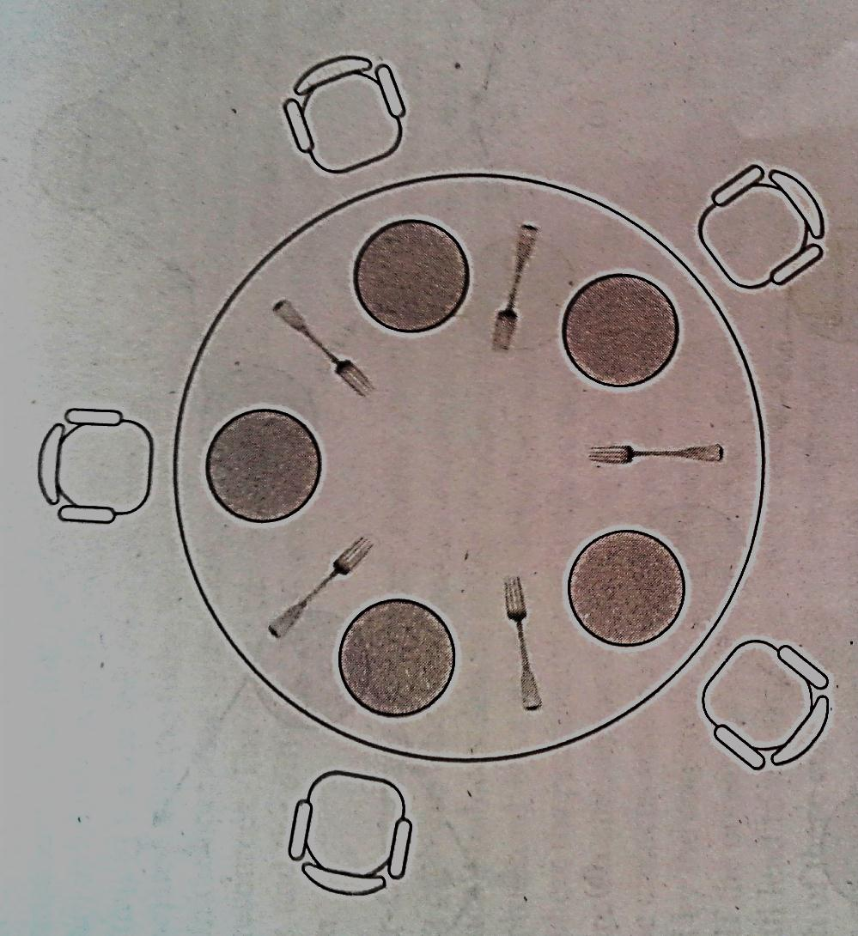
The Dining Philosopher’s problem
Five philosopher are sitting around a round table, involved in eating and brainstorming.
At any point of time each person involves in either eating, hungry or brainstorming.

Slide 113
The Dining Philosopher’s problem
For eating each philosopher requires 2 forks, but there are only five forks present on table and they are arranged in a fashion one fork between two philosophers.
Philosopher can use the forks on his/her immediate left and right, that too in the order pickup left fork first and then the right fork.

Slide 114
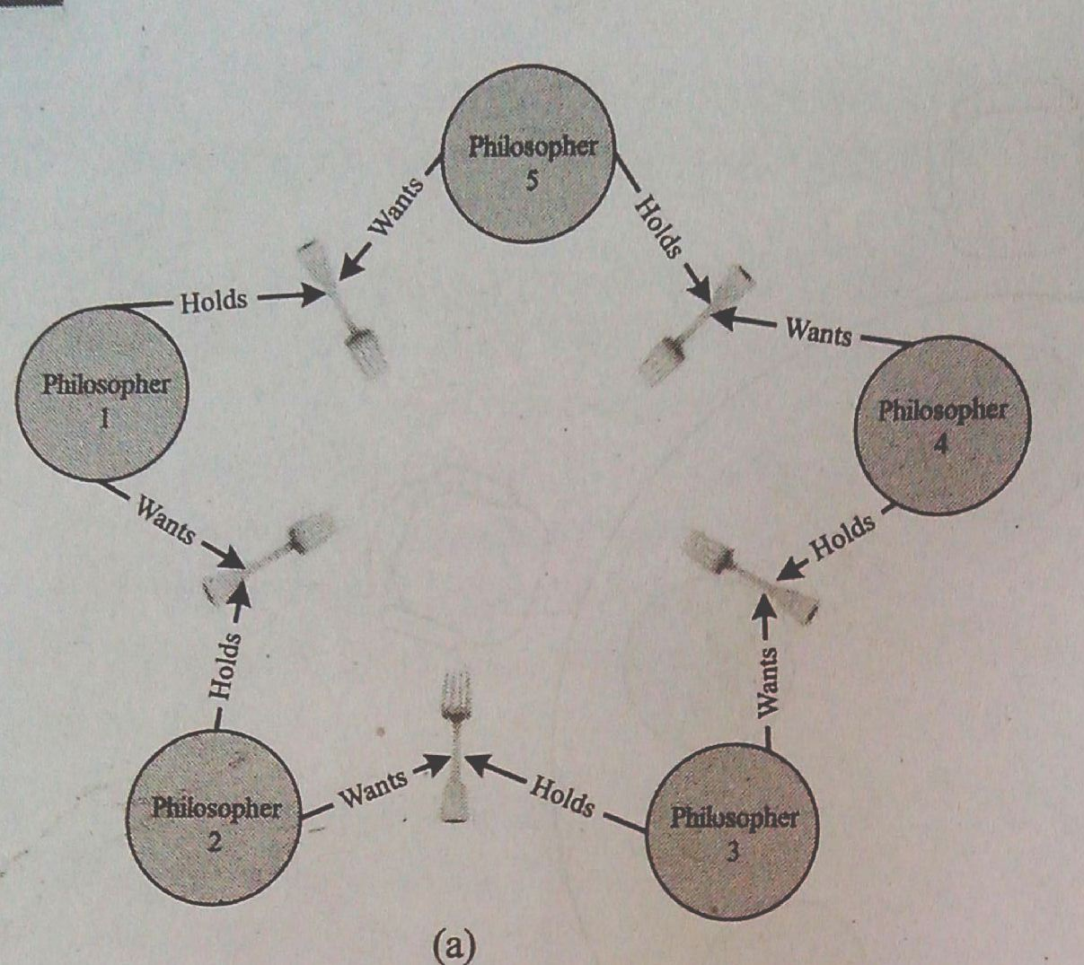
The Dining Philosopher’s problem
Lets analyze the various scenarios that may occur in this situation.
Scenario1:
All the philosophers involve in brainstorming together and try to eat together. All the philosophers picks up the left fork and is unable to proceed since two forks are required for eating.
Philosopher1 thinks that philosopher2 sitting to the right of him/her will put the fork down and waits for it.

Slide 115
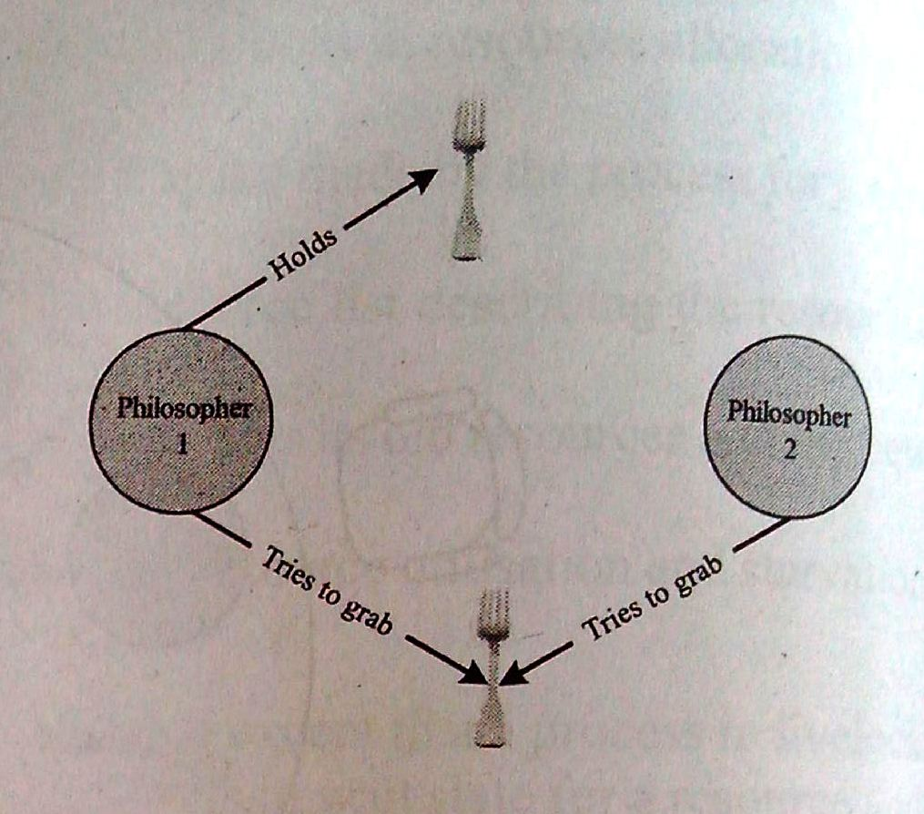
The Dining Philosopher’s problem
This situation forms circular chain of un-granted requests. They will not make any progress in eating and results in ‘starvation’ of the philosophers and ‘deadlock’.
Scenario2:
All the philosophers start brainstorming together, one of the philosopher is hungry and he/she picks up the left fork.
When the philosopher is about to pick the right fork, the philosopher sitting to his right also become hungry and tries to grab the left fork which is the right fork of his neighboring philosopher who is trying to lift it, resulting in a ‘Race condition’.

Slide 116
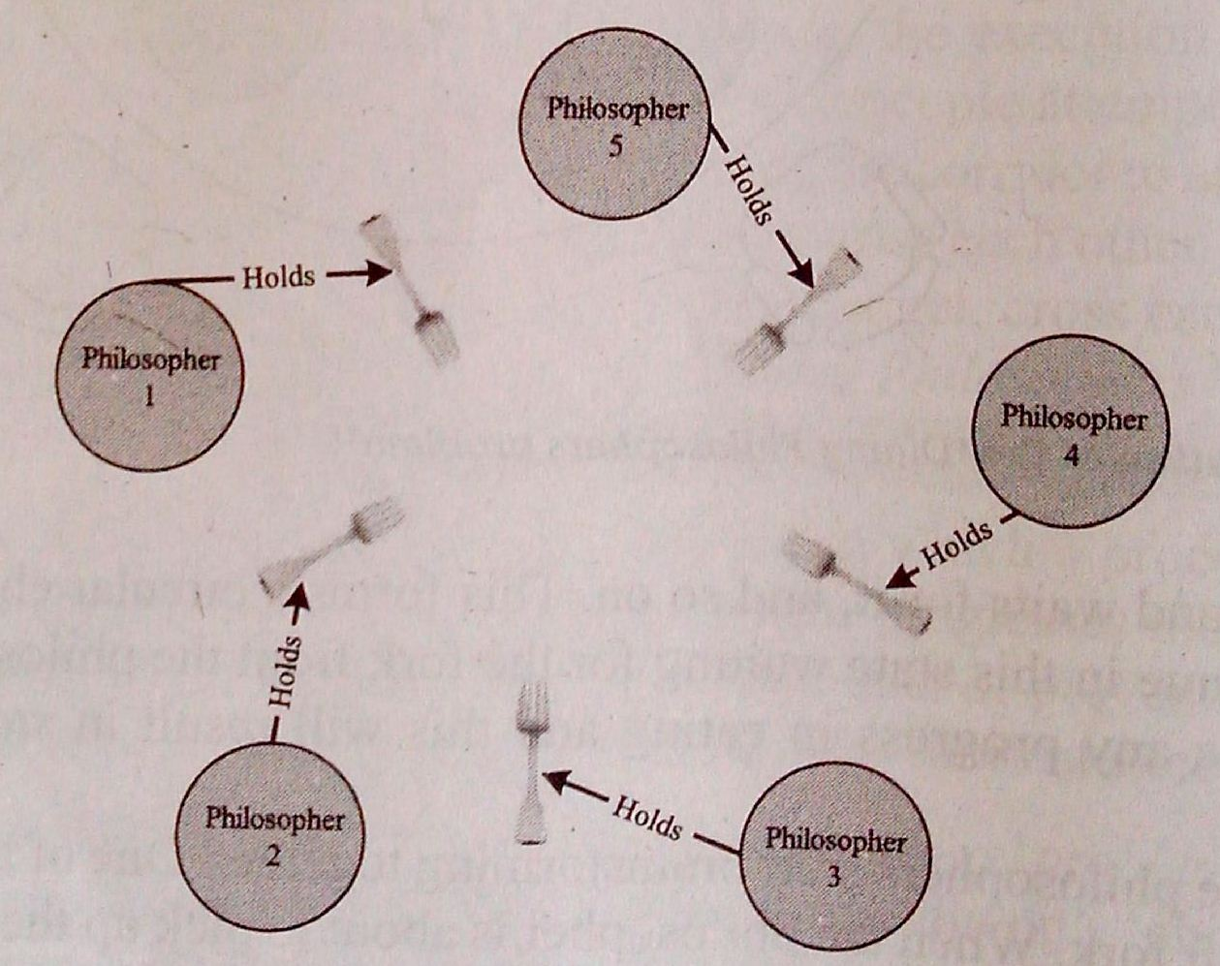
The Dining Philosopher’s problem
Scenario3:
All the philosophers involve in brainstorming together and try to eat together. Each philosopher picks up the left fork and is unable to proceed.
Each of them anticipates that the adjacently sitting philosopher will put his/her fork down and waits for a fixed duration and after this puts the fork down.
Since all the philosophers try to lift the fork at the same time, none of them will be able to get two forks.
Leads to Livelock and starvation condition.

Slide 117
The Dining Philosopher’s problem
Solution:
The situation can be handled in many ways by allocating the forks in different allocation techniques including round robin allocation, FIFO allocation, etc.
One of the solution is that
Imposing rules in accessing the forks by philosophers, like: The philosophers should put down the fork he/she already have in hand after waiting for a fixed duration for the second fork and should wait for fixed time before making the next attempt.
This solution works fine to some extent, but if all the philosophers try to lift the forks at the same time, a livelock situation is resulted.

Slide 118
The Dining Philosopher’s problem
Another solution which gives maximum concurrency that can be thought of is each philosopher acquires a semaphore(mutex) before picking up any fork.
When a philosopher feels hungry he/she checks whether the philosopher sitting next to him is holding a fork, by checking the state of the associated semaphore.
If the forks are in use by neighboring philosophers, the philosopher waits till the forks are available. A philosopher when finished eating puts the forks down and informs the philosophers sitting to his/her left and right, who are hungry, by signaling the semaphores associated with forks.

Slide 119
Producer-consumer/Bounded Buffer Problem
Is a common data sharing problem where two processes concurrently access a shared buffer with fixed size.
A thread/process which produces data is called ‘Producer thread/process’ and a thread/process which consumes the data is called ‘Consumer thread/process’.
Imagine a situation where producer keeps on producing data and puts it into the buffer and the consumer thread keeps on consuming the data from buffer and there is no synchronization between the two.

Slide 120
Producer-consumer/Bounded Buffer Problem
There may be chances where the producer produces data at a faster rate than the rate at which it is consumed by the consumer, this will lead to ‘buffer overrun’.
If the consumer tries to consume the data at a faster rate than the rate at which it is produced by the producer, will lead to ‘buffer under-run’.
Both these conditions lead to inaccurate data and data loss.
Solution to this problem is the ‘sleep and wakeup’.

Slide 121
Readers-Writers Problem
Is a common issue observed in processes trying to compete each other for limited shared resources.
Multiple processes trying to read and write shared data concurrently.
Typical example is banking system where one process tries to read the account details while the other processes try to update the available balance available for that account.
Multiple processes reading the shared data is not a big issue, but multiple processes trying to write and read concurrently causes inconsistent results.

Slide 122
Priority Inversion
Is the byproduct of the combination of blocking based(lock based) process synchronization and pre-emptive priority scheduling.
‘Priority Inversion’ is the condition where the high priority processes needs to wait for a low priority process to release a resource which is shared between the high priority process and the low priority process, and a medium priority process which doesn’t require the shared resource continue its execution by pre-empting the low priority process.

Slide 123
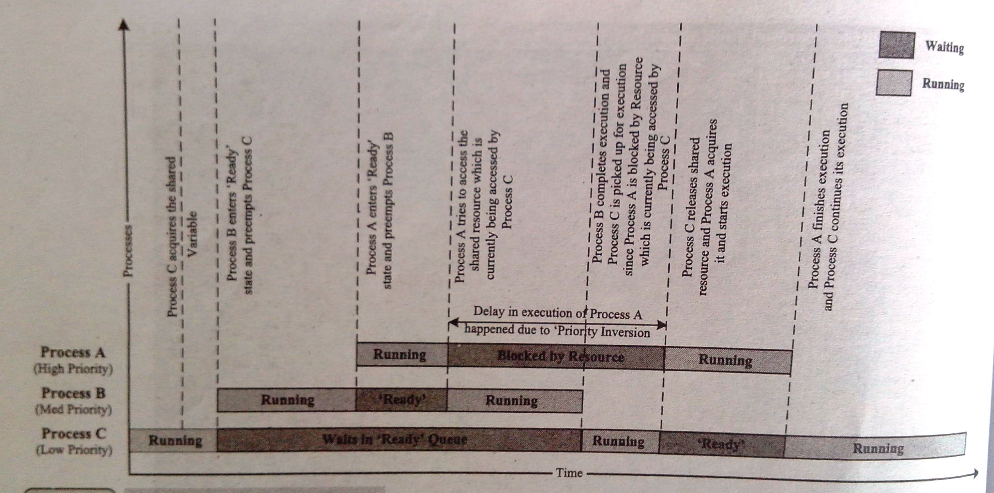
Priority Inversion

Slide 124
Priority Inversion
The commonly adopted priority inversion workarounds are
Priority Inheritance:
A low-priority task that is currently accessing(by holding the lock) a shared resource requested by a high-priority task temporarily ‘inherits’ the priority of that high-priority task, from the moment the high-priority task raises the request.
The priority of the low priority task which is temporarily boosted to high is brought to the original value when it releases the shared resource.

Slide 125
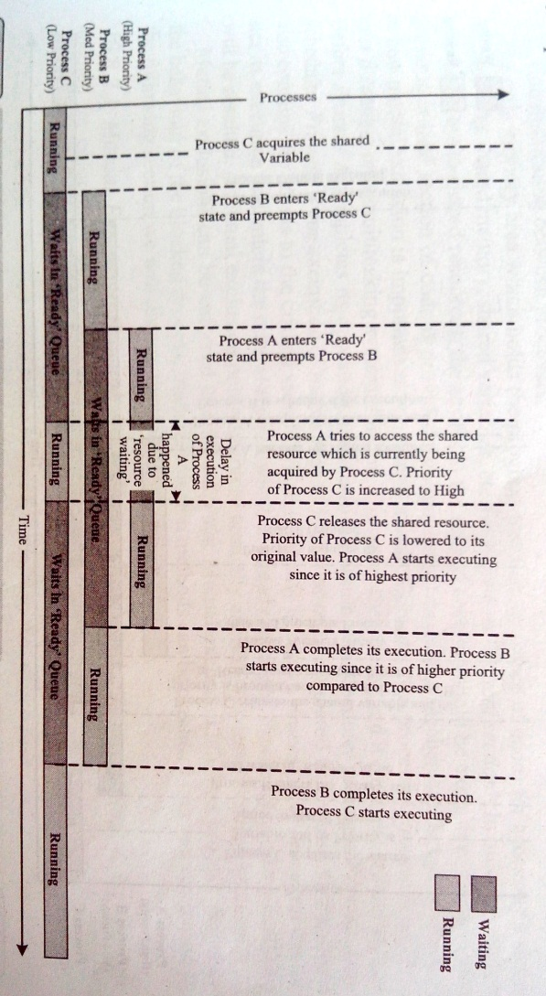
Priority Inheritance

Slide 126
Priority Inversion
Priority inheritance is only a work around and it will not eliminate the delay in waiting the high priority task to get the resource from the low priority task.
The only thing is that it helps the low priority task to continue its execution and release the shared resource as soon as possible.
The moment, at which the low priority task releases the shared resource, the high priority task kicks the low priority task out and grabs CPU. A true form of selfishness.

Slide 127
Priority Inversion
Priority Ceiling:
In this a priority is associated with each shared resource. The priority associated to each resource is the priority of the highest priority task which uses this shared resource, this priority level is called ‘Ceiling Priority ’.

Slide 128
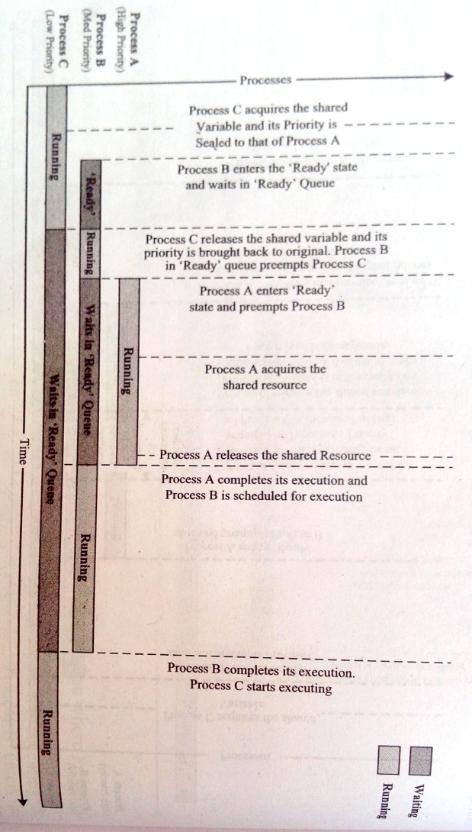
Priority Ceiling

Slide 129
Task Synchronization techniques
Process/Task synchronization is essential for
Avoiding conflicts in resource access(racing, deadlock, starvation, livelock etc.) in a multitasking environment.
Ensuring proper sequence of operation across processes. Producer consumer problem is a typical example for processes requiring proper sequence of operation.
Communicating between processes.

Slide 130
Task Synchronization techniques
The code memory area which holds the program instructions for accessing a shared resource is known as ‘critical section’.
Mutual exclusion policy enforces mutual access of critical sections.
Process A
Running
preemption
Critical
Process B

Slide 131
Task Synchronization techniques
Mutual exclusion can be enforced into many ways. Mutual exclusion blocks a process.
Based on the behavior of the blocked process, mutual exclusion methods can be classified into two categories. They are
1. Mutual Exclusion through Busy Waiting/Spin Lock
2. Mutual Exclusion through Sleep and Wakeup

Slide 132
Task Synchronization techniques
Mutual Exclusion through Busy Waiting/Spin Lock:
Simplest method for enforcing mutual exclusion.
Uses a lock variable for implementing mutual exclusion.
Process checks this lock before entering critical section.
If LOCK is set to ‘1’ means critical section is already in use by other processes.
If LOCK is set to ‘0’ means critical section is free for other processes.
The challenge in using this method is non-availability of single atomic instruction which combines reading, comparing and setting of the lock variable.

Slide 133
Task Synchronization techniques
The three different operations regarding locks are
1. Operation of reading the lock variable.
2. Checking its present value.
3. Setting it.
Process1 reads the lock variable for critical section and is about to set it when it is available, but at the same time process2 preempts the process1 and the process2 is in execution, it acquires the lock for critical section.
After some time while process2 is in critical section and the scheduler preempts process2 and schedules process1 before process2 leaves the critical section.
Now process1 sets the lock variable and enters the critical section.
It violates the mutual exclusion policy and may produce unpredicted results.
TSL instruction for testing and set the lock, along with CMPXCHG-Compare and Exchange. CMPXCHG dest, src

Slide 134
Task Synchronization techniques
The lock based mutual exclusion implementation always checks the state of the lock and waits till the lock is available.
This keeps processes always busy and forces the processes to wait for the availability of lock so called ‘Busy Waiting’ and the ‘Spin Lock’ is nothing but the processes always spins for the lock to be available.
Wastage of CPU time and Power consumption is high.
Interlocked operations are the most efficient synchronization primitives when compared to lock based synchronization techniques.
Interlocked operation is free from waiting, if the lock is not available at the time of request it simply performs the operation and returns immediately.
The interlocked function call is directly converted to a processor specific instruction and there is no user mode to kernel mode transition as in the case of mutex, semaphore and critical section objects.

Slide 135
Task Synchronization techniques
Mutual Exclusion through Sleep and Wakeup:
It is an alternative to busy waiting policy.
In this when a process is not allowed to access the critical section, which is currently being locked by another process, the process undergoes into ‘sleep mode’ and enters ‘blocked state’.
The process which is blocked on waiting for access to the critical section is awakened by the process which currently owns the critical section.

Slide 136
Task Synchronization techniques
The sleep and wakeup policy for mutual exclusion can be implemented in different ways. They are
Semaphore
Binary semaphore(Mutex)
Counting semaphore
Critical Section Objects
Events

Slide 137
Sleep and Wakeup Policy Implementations
Semaphore:
Is a sleep and wakeup based mutual exclusion implementation for shared resource access.
Semaphore is a system resource and the process which wants to access the shared resource can first acquire this system object to indicate the other processes which wants the shared resource that the shared resource is currently acquired by it.

Slide 138
Sleep and Wakeup Policy Implementations
The resources which are shared among a process can be either for exclusive use by a process or for using by a number of processes at a time.
Display Device
Hard Disk of a system is a typical example for sharing the resource among a limited number of multiple processes.
Various processes can access the different sectors of the hard-disk concurrently.

Slide 139
Sleep and Wakeup Policy Implementations
Based on the implementation of the sharing limitation of the shared resource, semaphores are classified into two; namely ‘Binary Semaphore’ and ‘Counting Semaphore’.
Binary semaphore:
Binary Semaphore provides exclusive access to shared resource by allocating the resource to a single process at a time and not allowing the other processes to access it when it is being owned by a process.
OS kernel dependent.
Under certain OS kernel it is referred as ‘Mutex’.

Slide 140
Sleep and Wakeup Policy Implementations
Any process can create ‘mutex object’ and other process of the system can use this ‘mutex object’ for synchronizing the access to critical sections.
Only one process can acquire or own this mutex object at a time.
State of a mutex object is set to signalled when it is not owned by any process and set to non-signalled when it is owned by any process.
Example: Hotel rooms

Slide 141
Sleep and Wakeup Policy Implementations
Counting semaphore:
In this type it limits the access of resources by a fixed number of process.
Maintains a count between zero and a finite value, and limits the usage of the resource to the maximum value of the count supported by it.
State of the counting semaphore object is set to ‘signalled’ when the count of the object is greater than zero.

Slide 142
Sleep and Wakeup Policy Implementations
The count associated with a ‘semaphore object’ is decremented by one when a process acquires it and the count is incremented by one when it releases the ‘semaphore object’.
The state of semaphore object is set to non-signalled when the semaphore is acquired by the maximum number of process that the semaphore can support(semaphore object becomes zero).

Slide 143
Sleep and Wakeup Policy Implementations
Counting semaphores are similar to binary semaphores in operation.
The only difference between them is that binary semaphore can only be used for exclusive access, whereas counting semaphores are used for both exclusive and limited access.
Example: Dormitary

Slide 144
Sleep and Wakeup Policy Implementations
Critical section Objects:
Same as the mutex object except that critical section object can only be used by the process of a single process(Intra Process).
The piece of code which needs to be made as critical section is placed at the ‘critical section’ area by the process.
The process creates a ‘critical section’ area by creating a variable type CRITICAL_SECTION.
The critical section must be initialised before the threads of a process can use it for getting exclusive access.

Slide 145
Sleep and Wakeup Policy Implementations
Events:
Event object is a synchronization technique which uses notification mechanism for synchronization.
In concurrent execution we may come across situations which demand the processes to wait for a particular sequence for its operations.
Similar to producer-consumer.

Slide 146
Device Drivers
Piece of software that acts as a bridge between OS and the hardware.
All the devices related access should flow through the OS kernel and the OS kernel routes it to the concerned hardware peripheral.
OS provides interfaces in the form of Application Programming Interfaces (API’s) for accessing the hardware.
Device drivers are responsible for initiating and managing the communication with the hardware peripherals.

Slide 147
Device Drivers
Certain drivers come as part of the OS kernel and certain drivers need to be installed on the fly.
Certainly the OS will not contain the drivers for all drivers for all devices and peripherals.
If an external device, whose driver software is not available with OS kernel image, is connected to the embedded device, the OS prompts to the user to install its driver manually.

Slide 148
Device Drivers
Device drivers which are part of the OS image are known as ‘Built-in drivers’ or ‘On-board drivers’. These drivers are loaded by the OS at the time of booting the device and are always kept in RAM.
Drivers which need to be installed for accessing a device are known as ‘Installable drivers’. These drivers are loaded by the OS on a need basis.
OS dependent.

Slide 149
Device Drivers
Very essential to know the hardware interfacing details like memory address assigned to the device, the interrupt used etc. of on-board peripherals for writing a driver for that peripheral.
Some RTOS systems support a layered architecture for the driver which separates out the low level implementation from the OS specific interface.
Low level implementation part is generally known as Platform Dependent Device(PDD) layer. The OS specific interface part is known as Model Device Driver (MDD) or Logical Device Driver(LDD).

Slide 150
Device Drivers
The driver files are usually in the form of a dll file.
Drivers can run in either user space or kernel space. Drivers which run in user space are known as user mode drivers and the drives which run in kernel space are known as kernel mode drivers.
Device driver implements the following:
Device(Hardware) Initialization and Interrupt configuration
Interrupt handling and processing
Client interfacing(Interfacing with user applications)

Slide 151
How to choose an RTOS
A lot of factors need to be analyzed carefully before making a decision on the selection of an RTOS. These factors can be either functional or non-functional.
Functional Requirements
Processor Support:
It is not necessary that all RTOS’s support all kinds of processor architecture. It is essential to ensure the processor support by the RTOS.

Slide 152
Functional Requirements
Memory Requirements:
OS requires ROM for holding the OS files and it is normally stored in a non-volatile memory like FLASH.
OS also requires working memory RAM for loading the OS services.
Real time Capabilities:
Not mandatory that OS for all embedded systems need to be Real-time and all embedded OS are ‘Real-time’ in behavior.

Slide 153
Functional Requirements
Kernel and Interrupt Latency:
The kernel of the OS may disable interrupts while executing certain services and it may lead to interrupt latency.
Inter process Communication and Task Synchronization:
OS kernel dependent.
Certain kernels may provide a bunch of options whereas other provide very limited options.

Slide 154
Functional Requirements
Modularization Support:
Most OS provide a bunch of features. At times it may not be necessary for an embedded product for its functioning.
Useful if OS supports modularization where in which the developer can choose the essential modules and re-compile the OS image for functioning.
Support for Networking and Communication:
OS kernel may provide stack implementation and driver support for a bunch of communication interfaces and networking.

Slide 155
Functional Requirements
Development Language Support:
Certain OS include the run time libraries required for running applications written in languages like Java and C#.

Slide 156
Non-Functional Requirements
Custom developed or Off the Shelf
Depending upon the OS requirement, it is possible to go for the complete design of an operating system suiting the embedded system needs or use an off the shelf, readily available OS.
Depends on development cost, licensing fees for the OS, development time and availability of skilled resources.

Slide 157
Non-Functional Requirements
Cost:
The total cost for developing or buying the OS and maintaining it in terms of commercial product and custom build needs to be evaluated before taking a decision on the selection of OS.
Development and Debugging Tools Availability:
Choosing these tools is a critical decision making factor in selection of an OS for embedded design.

Slide 158
Non-Functional Requirements
Ease of Use:
How easy it is to use a commercial RTOS is another important feature that needs to be considered in the RTOS selection.
After Sales:
For commercial embedded RTOS, after sales in the form of e-mail, on-call services etc. for bug fixes, critical patch updates and support for production issues, etc. should be analyzed thoroughly.

